Slide 1


Introduction to Web Basics
This presentation offers a concise overview of essential web terminology designed for beginners. It aims to clarify the basic concepts and language commonly used in web development and design, providing a foundational understanding for those interested in the field.

Slide 2
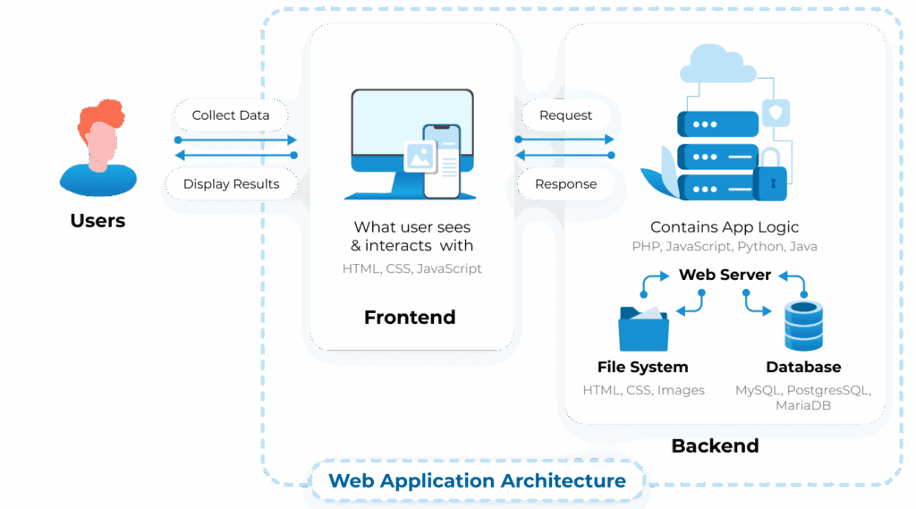

Slide 3
What is the Web?
The World Wide Web is a system of interlinked hypertext documents that allows users to access information via the Internet. Invented by Tim Berners-Lee in 1989, it has significantly transformed how we communicate and share information.
Definition
A system of interlinked hypertext documents accessed via the Internet.
History
Invented by Tim Berners-Lee in 1989 to facilitate information sharing.
Components
Includes web servers, web browsers, and web protocols.

Slide 4



Web Browsers
Web browsers play a crucial role in how we interact with digital content, providing tools for navigation, displaying web pages, and enhancing user experiences.
Functionality
2
Browsers interpret HTML, CSS, and JavaScript to render web pages.
Definition
A web browser is a software application used to access and view websites.
1
User Interface
Browsers typically feature a navigation bar, address bar, tabs, and a status bar.
3

Slide 5



Web Servers Overview
Definition
Functionality
Types
A web server is a computer system that stores, processes, and delivers web pages to users over the Internet. It responds to requests from web browsers.
When a user enters a URL, the browser sends a request to the web server, which retrieves the requested content and sends it back, allowing the browser to display it.
Different types of web servers exist, including Apache, Nginx, and Microsoft IIS, each with unique features and configurations suitable for various needs.

Slide 6

Understanding Hypertext and HTML
Hypertext Concept
HTML Definition
HTML Elements Overview
Hypertext links to documents via clickable links, facilitating navigation.
HTML is the standard markup language to create web pages.
HTML uses tags to represent elements like headings, paragraphs, and links.

Slide 7



CSS and Styling Overview
Selectors and Properties
2
CSS uses selectors to target HTML elements and applies properties to them.
Definition
Cascading Style Sheets (CSS) is a stylesheet language used to describe the presentation of HTML documents.
1
Responsive Design
CSS enables responsive design, allowing adaptation to different screen sizes and devices.
3

Slide 8

and Interactivity
JavaScript plays a crucial role in creating interactivity and enhancing the user experience on websites. It allows real-time updates, improving engagement and functionality for users.
Definition
Functionality
Libraries and Frameworks
JavaScript is a high-level programming language used to create dynamic and interactive web content.
JavaScript can manipulate HTML elements, respond to user events, and validate forms.
Popular JavaScript libraries and frameworks simplify development and provide pre-built functions.

Slide 9


Understanding URLs and Domain Names
1
URL Definition
2
Domain Names
3
URL Structure
A Uniform Resource Locator (URL) is the address used to access a resource on the web.
A domain name is a human-readable address that corresponds to an IP address.
A typical URL has the format https://www.example.com/path/to/resource.

Slide 10
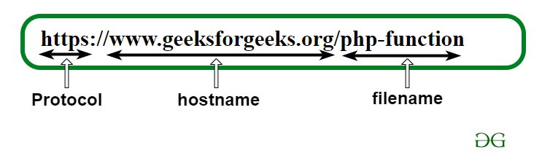
Understanding URL Structure

Slide 11
Understanding Web Hosting
Types
2
Various hosting options exist, including shared hosting, dedicated hosting, and cloud hosting.
Definition
Web hosting is a service that allows individuals and organizations to publish their websites on the Internet.
1
Domain Registration
3
Registering a domain name is crucial and often offered by hosting providers.

Slide 12



Search Engines and SEO
Search Engines
SEO Definition
Importance
Search engines like Google, Bing, and Yahoo help users find information on the web.
Search Engine Optimization (SEO) optimizes websites to rank higher in search engine results.
Effective SEO increases visibility and attracts organic traffic, crucial for digital marketing.

Slide 13
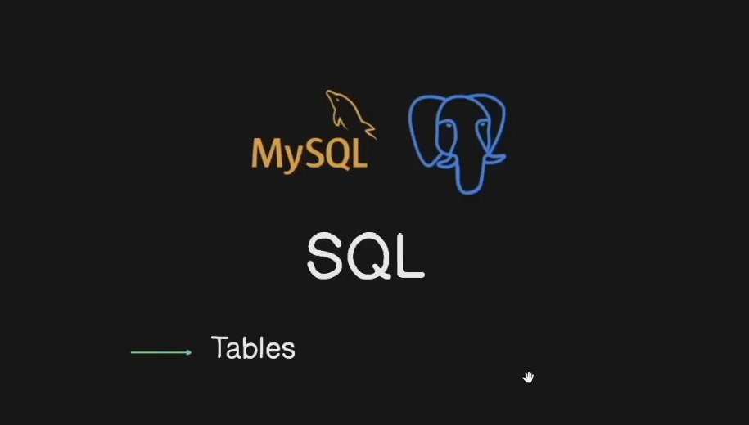
Database: MySQL vs NO-SQL (MongoDB)

Slide 14
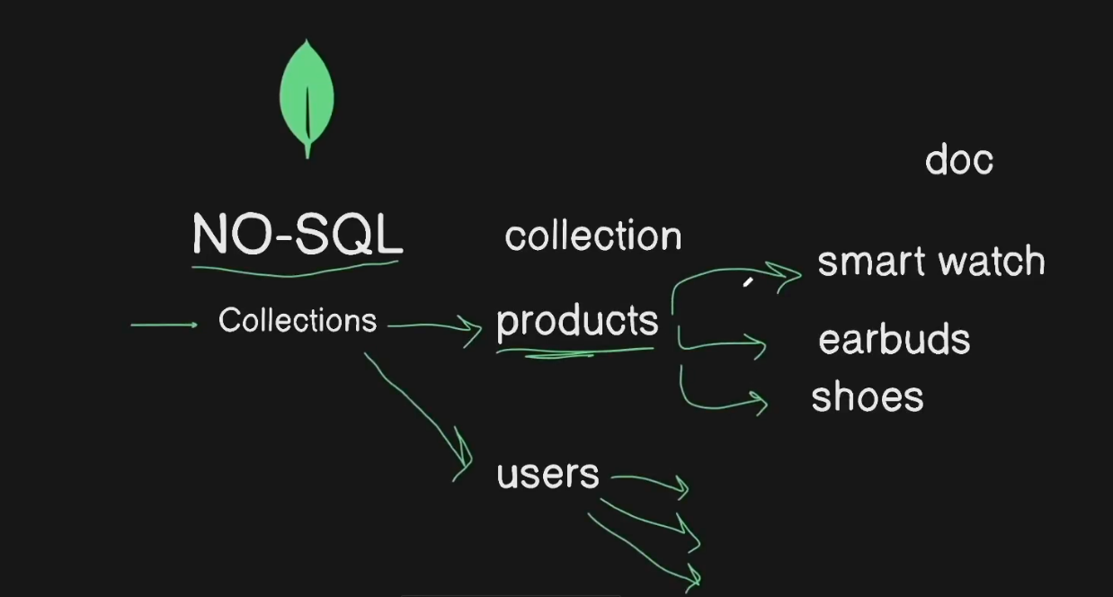
Database: MySQL vs NO-SQL (MongoDB)

